Slide 1
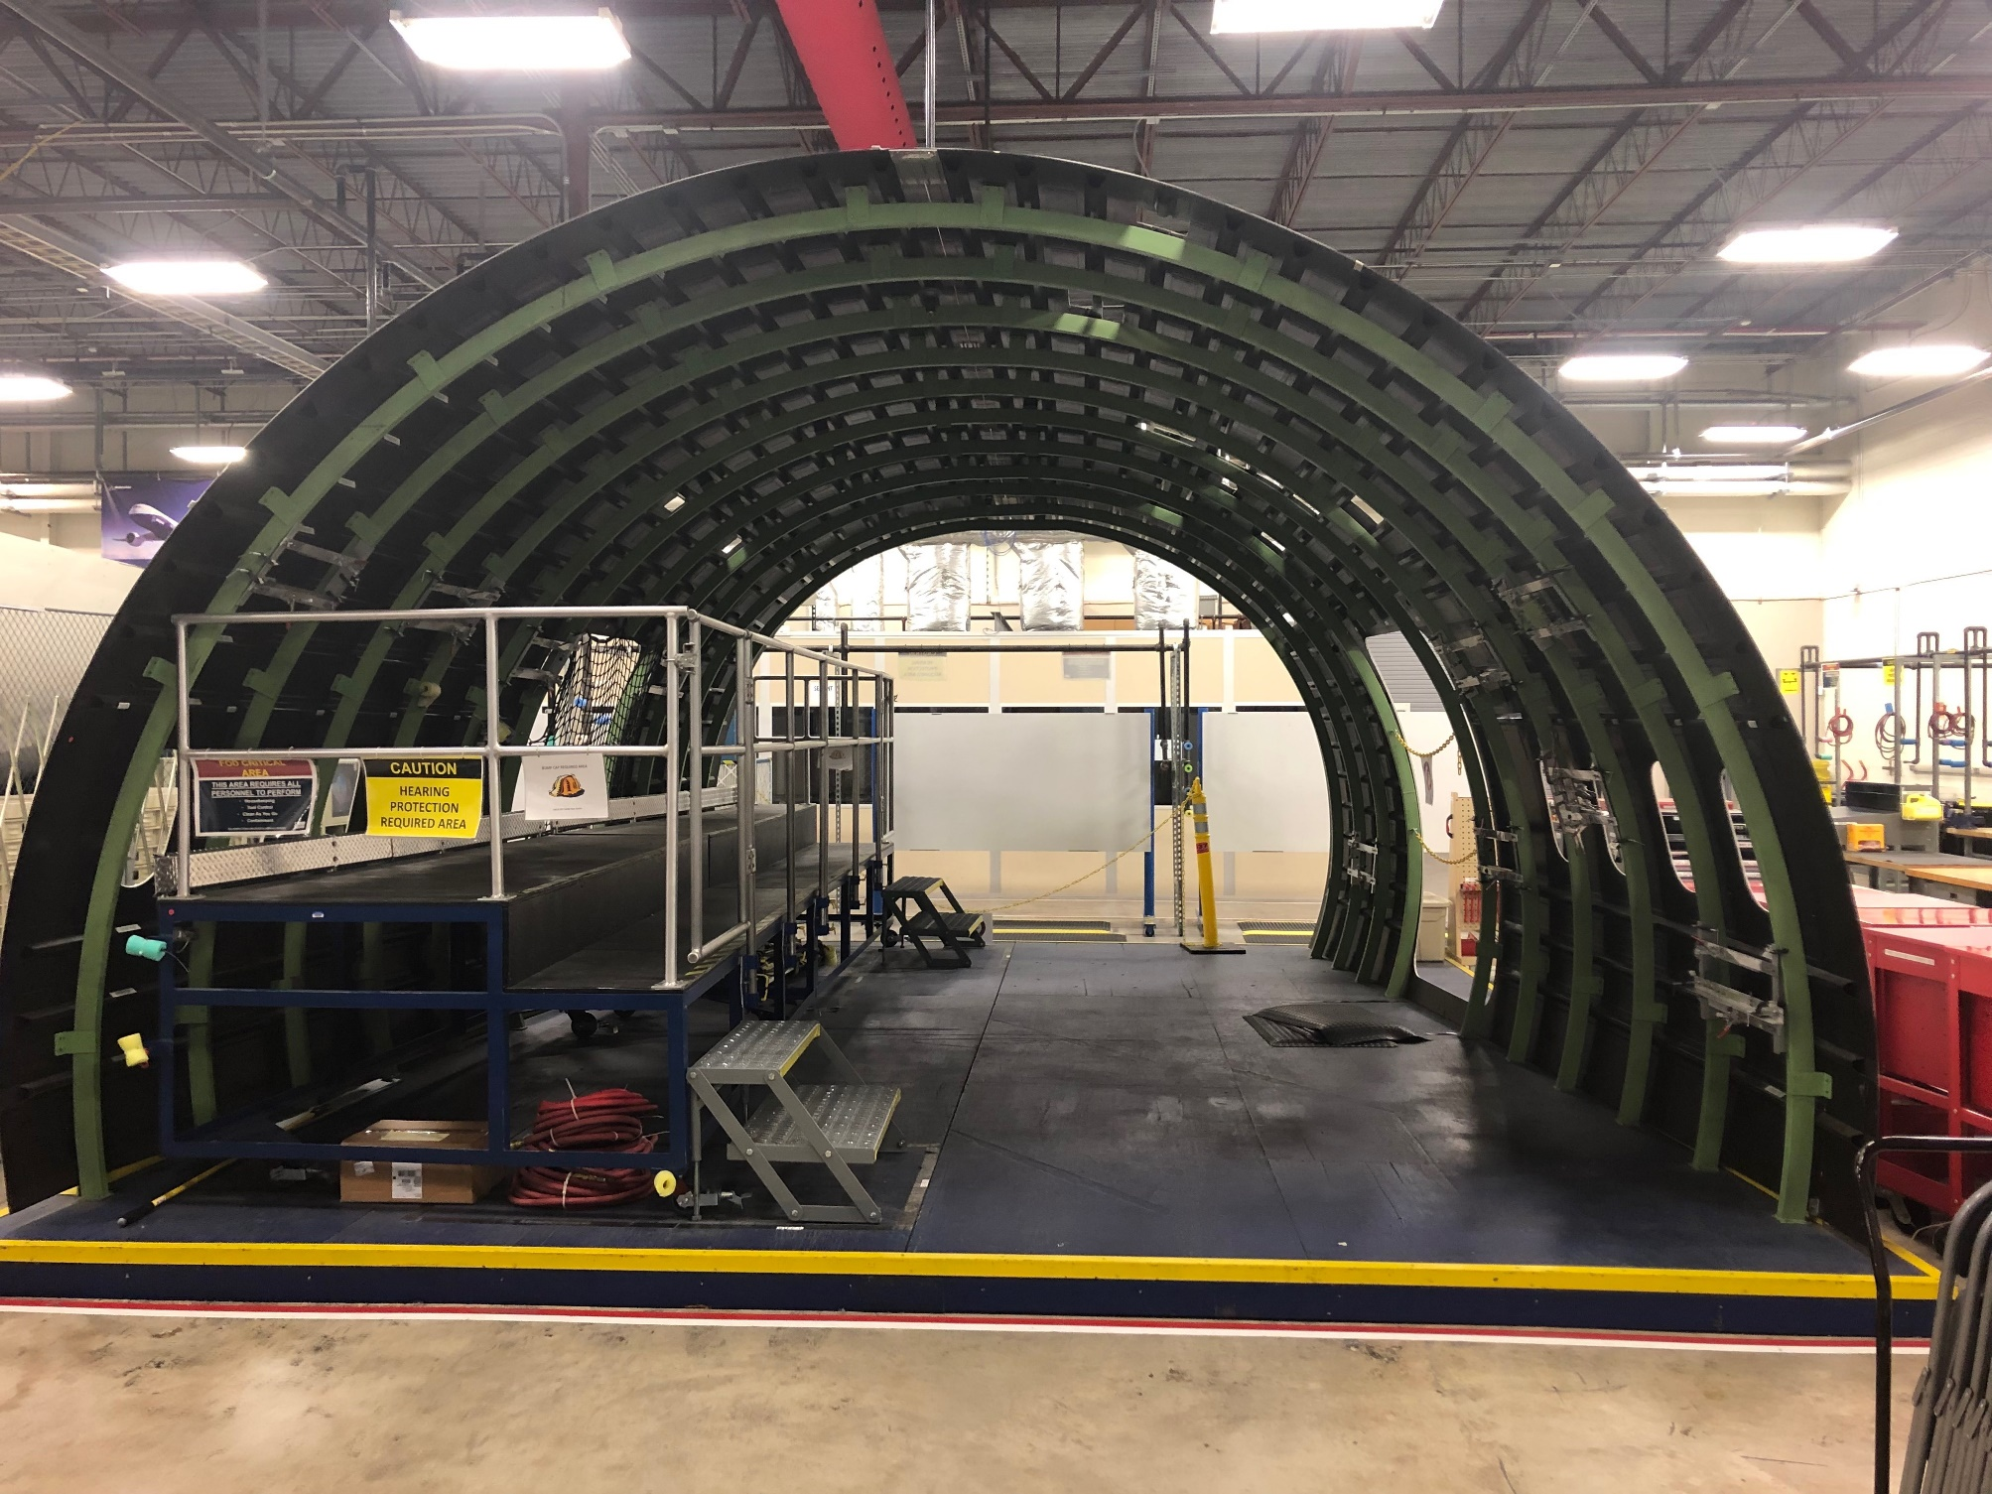
Upper Lobe

Slide 2
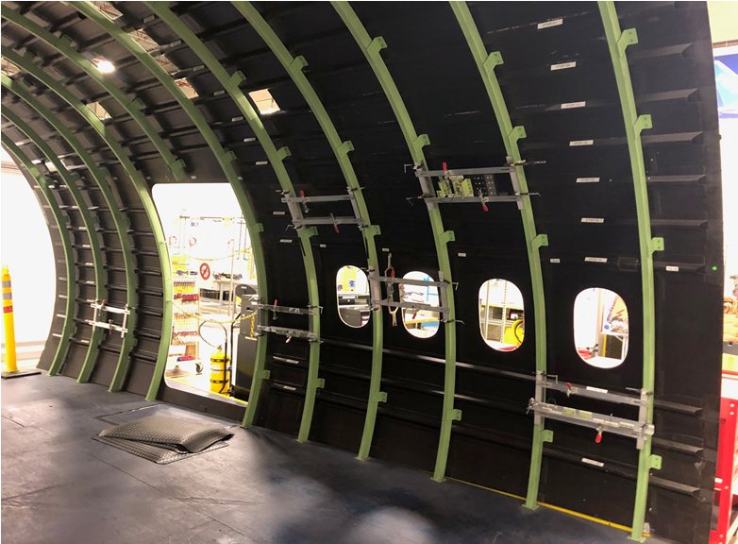
Upper Lobe Left Side

Slide 3
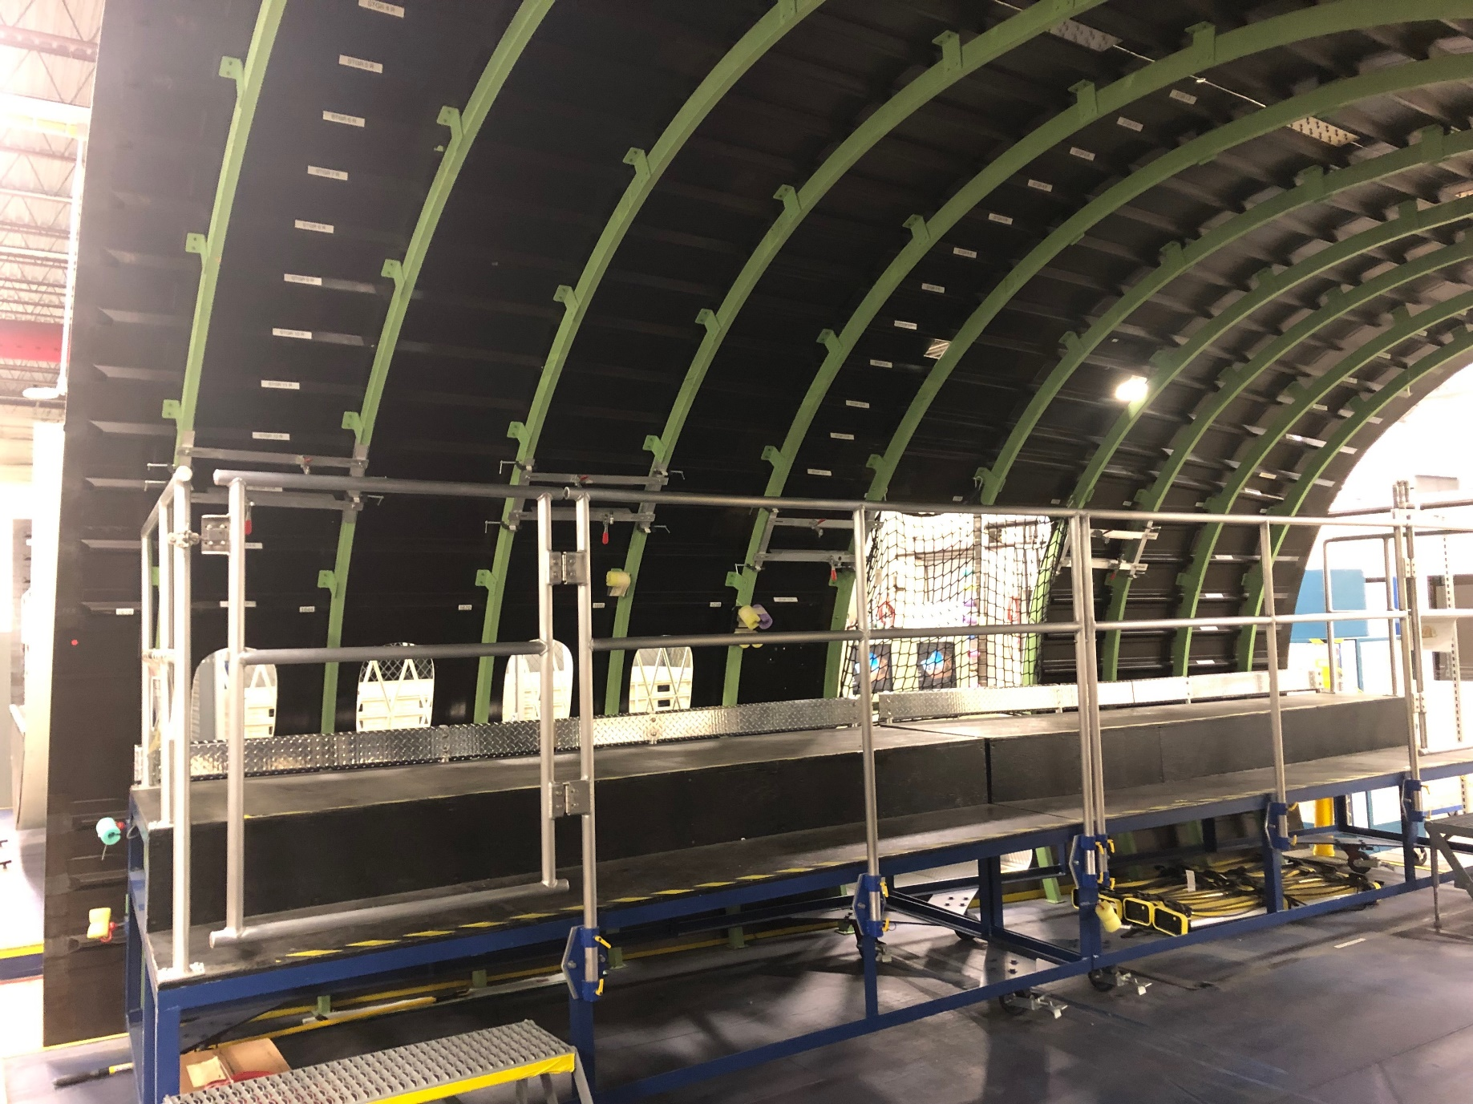
Upper Lobe Right Side

Slide 4
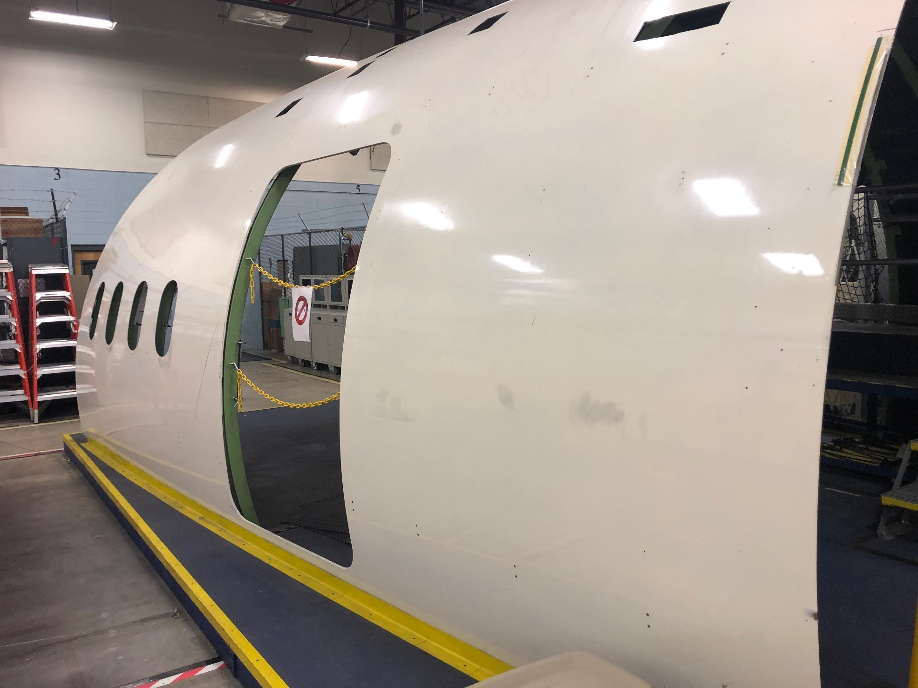
Upper Lobe Left Side

Slide 5
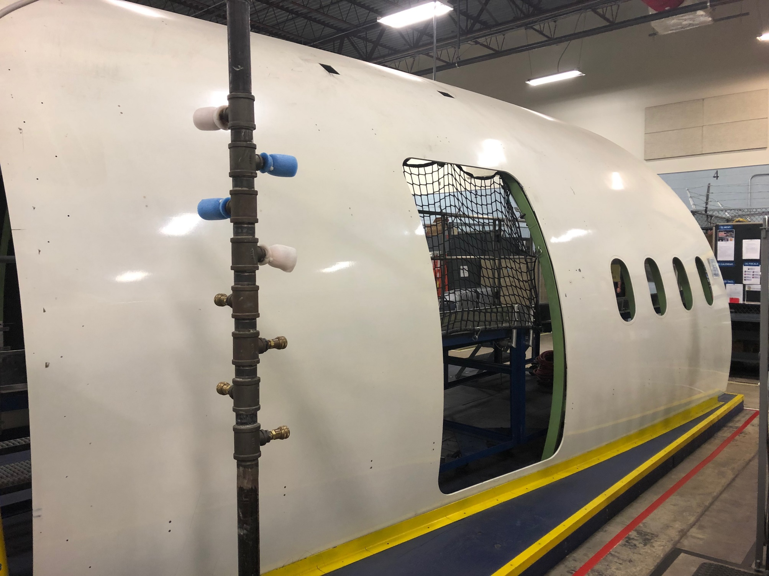
Upper Lobe Right Side

Slide 6
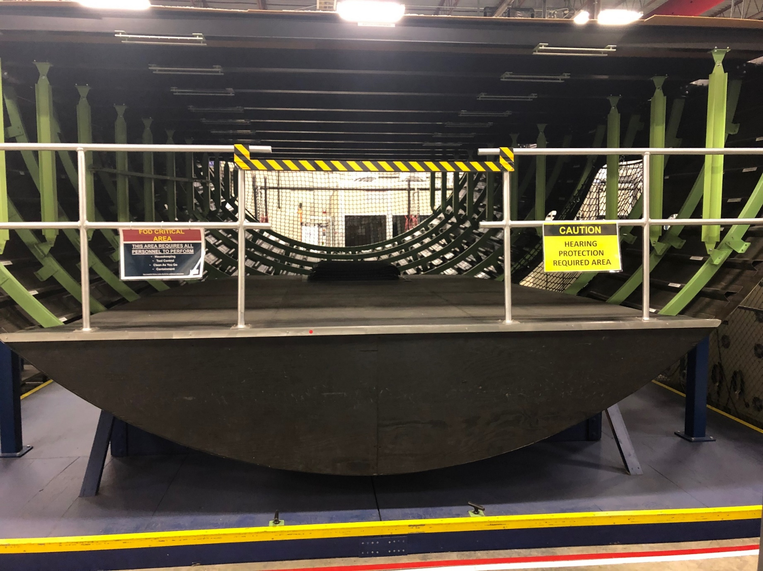
Lower Lobe

Slide 7
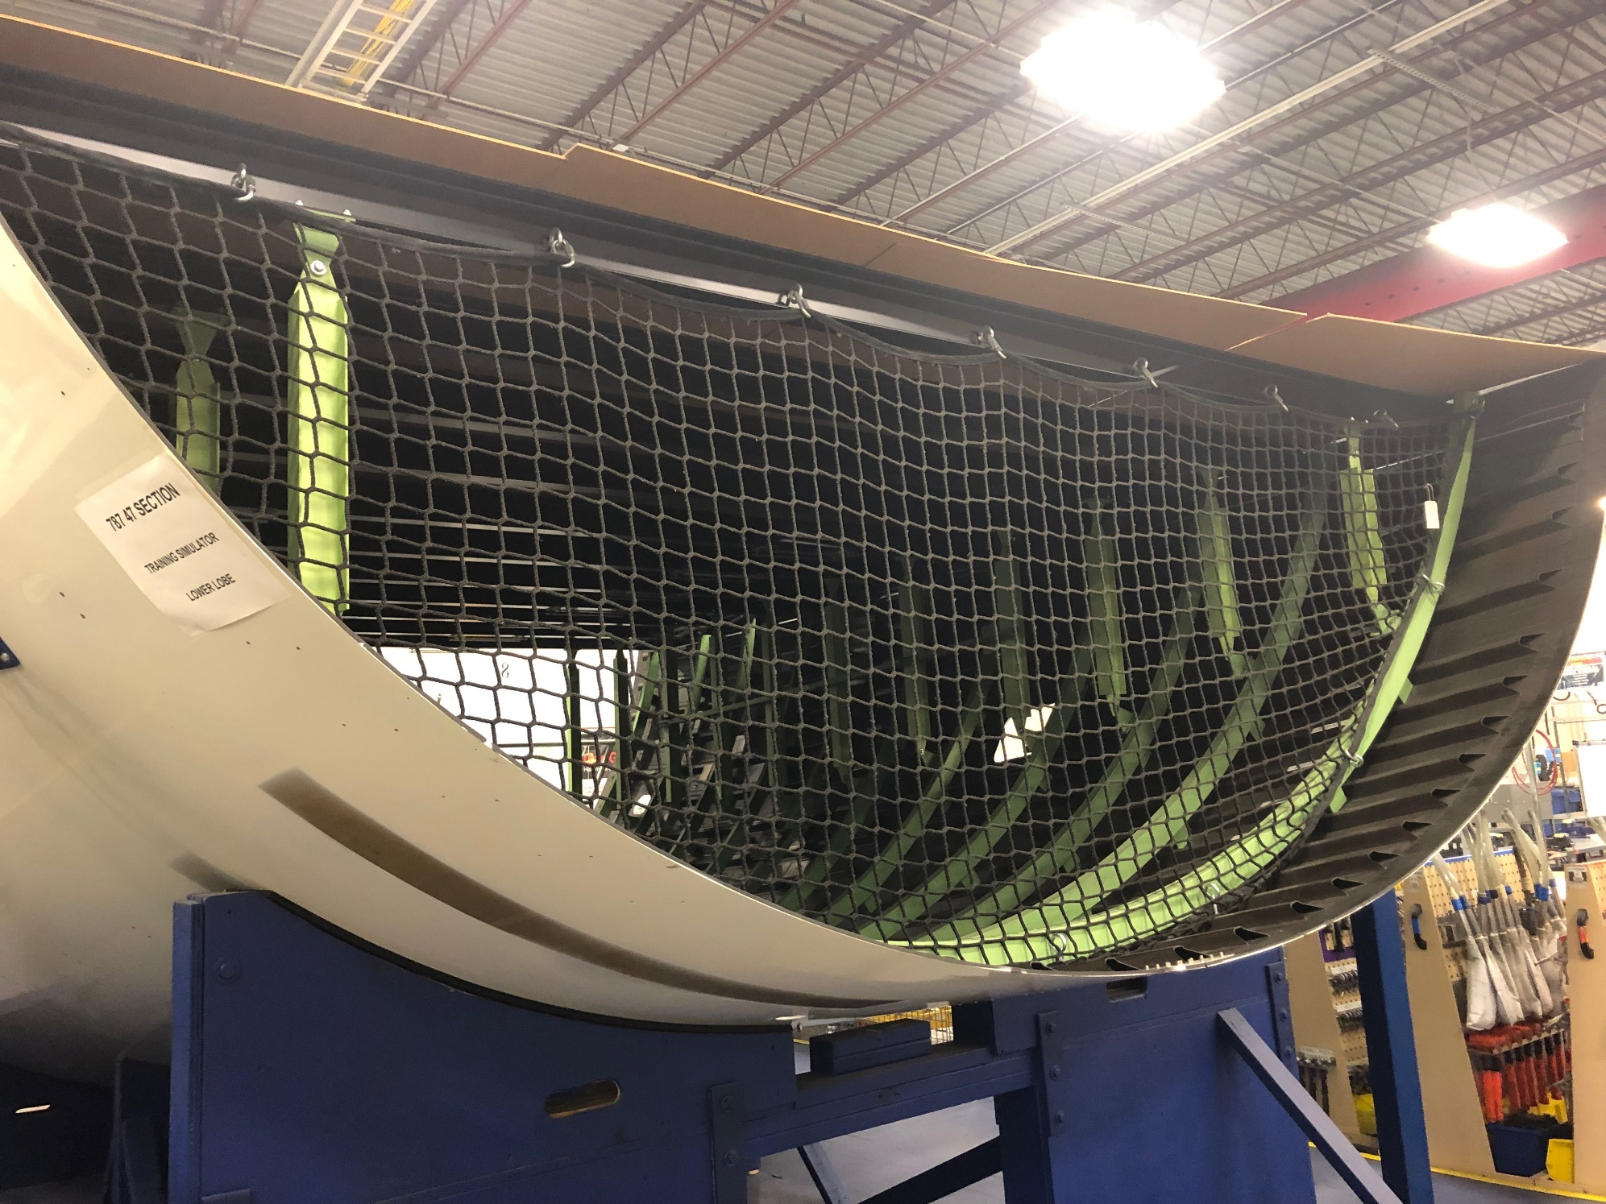
Lower Lobe

Slide 8
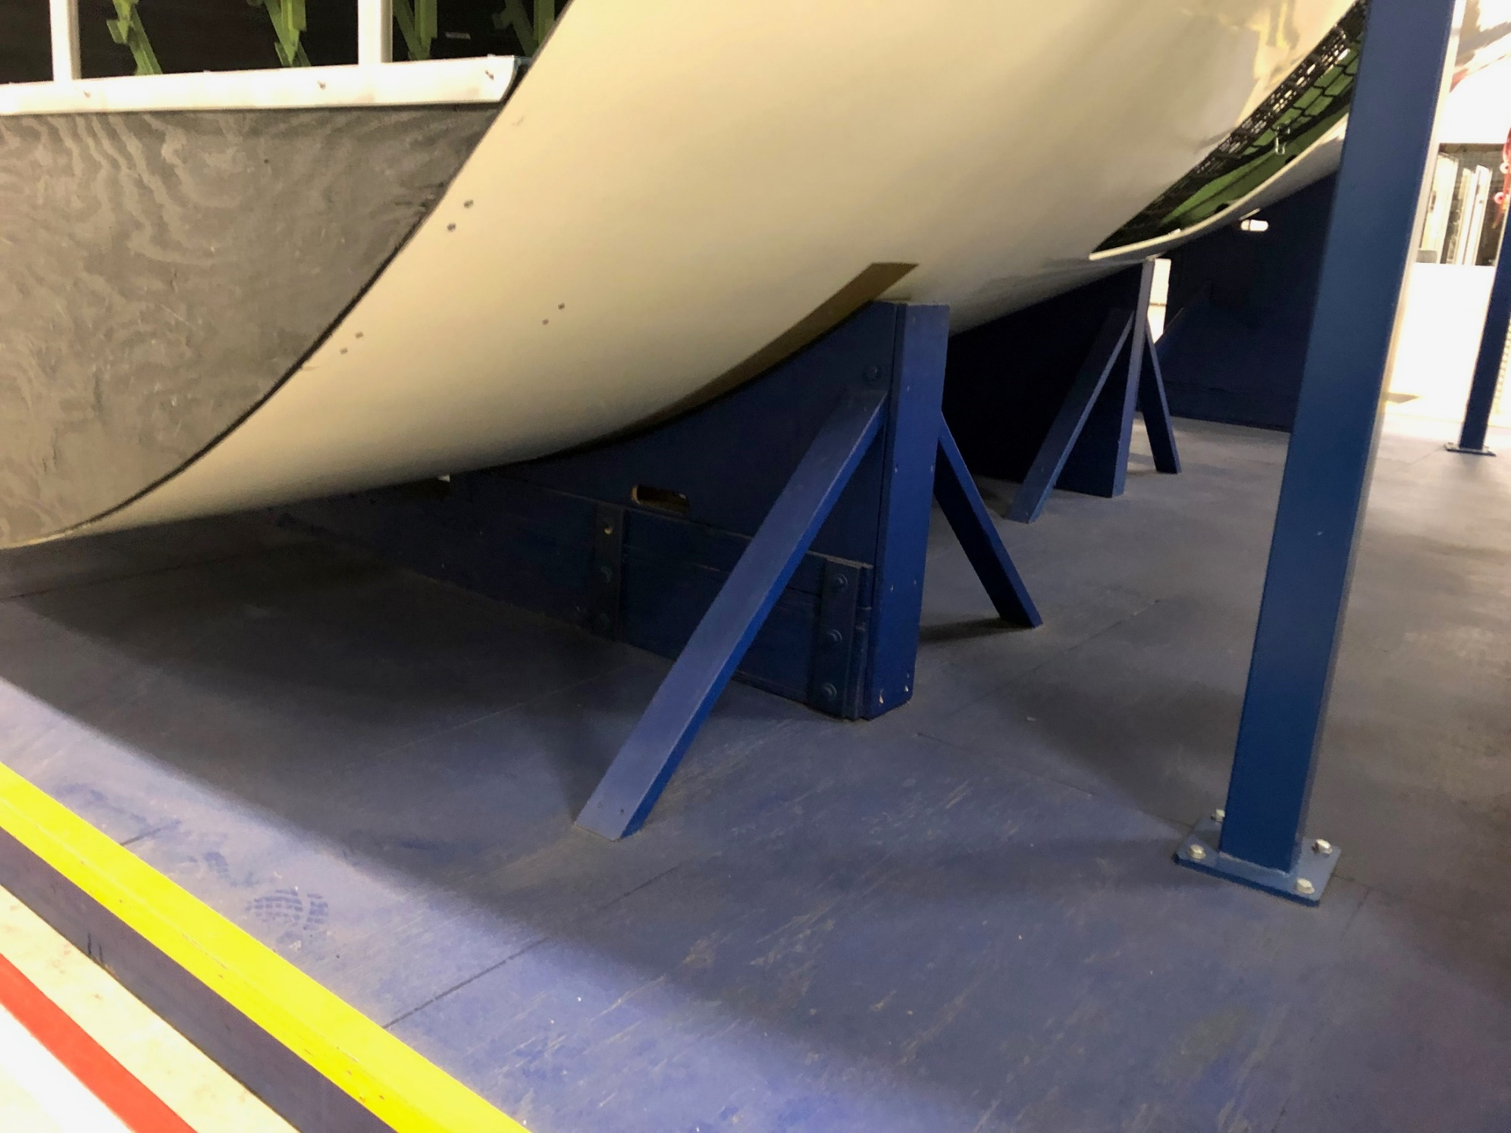
Lower Lobe

Slide 9
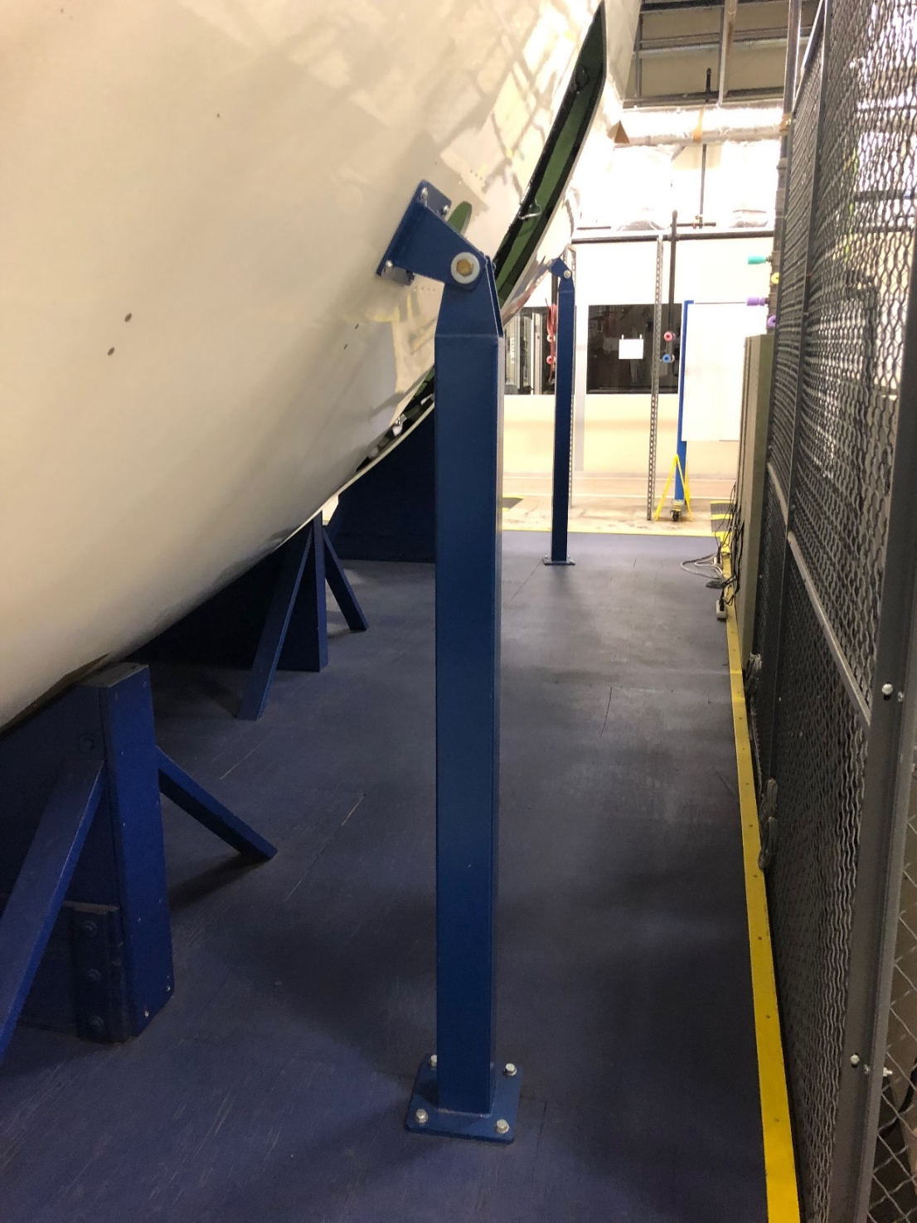
Lower Lobe

